Slide 1
Node js
Day 4
shimaa ismail

Slide 2
content
Hashing & Encryption
bycrpt js
JWT
Authentication
Authorization

Slide 3
Hashing & Encryption
Encryption (Two-Way)
Encryption is like a secret code. You take a message and scramble it with a key. Anyone with the right key can unscramble it back to the original.
Purpose: Protect data so only authorised people can read it.
Direction: Reversible (encrypt ↔ decrypt).
Example:
Plaintext: "Hello"
Encrypted: "U2FsdGVkX1/..."
With the correct key, you get back "Hello".
Hashing (One-Way)
Hashing is like a fingerprint. You take any input and run it through a hash function, which produces a fixed‑length string. You cannot reverse it to get the original input.
Purpose: Verify integrity or store sensitive data (like passwords) without keeping the original.
Direction: One-way only (no “un-hashing”).
Example:
Input: "Hello"
hash: "185f8db32271fe25f561a6fc938b2e264306ec304eda518007d1764826381969"
Use cases:
Storing passwords

Slide 4
bcryptjs
bcryptjs is a JavaScript library that implements the bcrypt password hashing algorithm.
It’s designed to securely store passwords by turning them into fixed-length, irreversible hashes that automatically include a unique salt for every password.
Once a password is hashed, you cannot turn it back into the original password.
A random salt is generated for each password . Even if two users have the same password, their hashes look completely different.
install =====> npm i bcryptjs

Slide 5
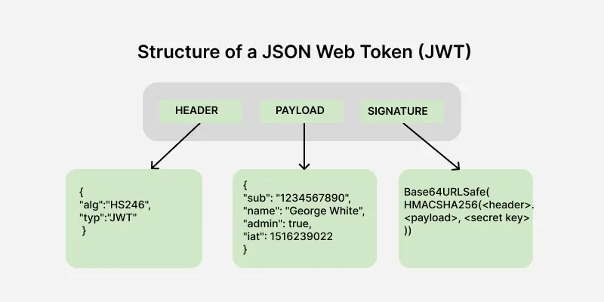
JWT (JSON Web Token)
is a secure way to send information between a client and a server. It is mainly used in web applications and APIs to verify users and prevent unauthorized access.
A JWT is a string that consists of three parts separated by dots (.):
npm install jsonwebtoken

Slide 6
How JWT Works
User logs in
Server generates a JWT – signs it with a secret (or private key).
Token is sent to the client – usually in an HTTP response (body, cookie, or header).
Client stores the token – in memory, localStorage, or cookie.
Client sends the token with every subsequent request
Server verifies the token – checks signature, expiration, etc.
If valid, server processes the request – extracting user info from payload.

Slide 7
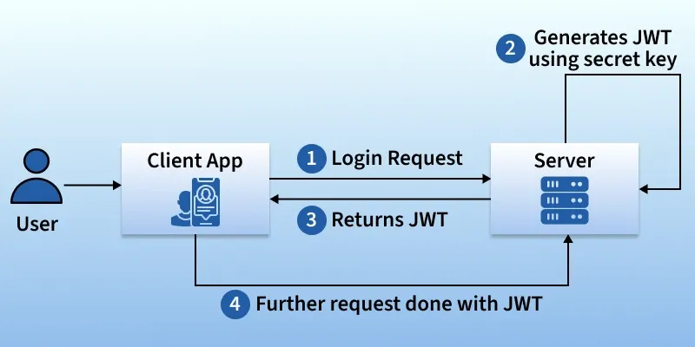
JWT

Slide 8
dotenv
dotenv is a zero-dependency Node.js module that loads environment variables from a .env file into process.env. It helps you keep sensitive configuration (API keys, database passwords, JWT secrets) separate from your source code.
npm install dotenv

Slide 9
Authentication vs Authorization
Authentication | Authorization
Who are you? | What can you do?
Login step | Access control step
Returns token/session | Uses token to check permissions
First (at login) | After authentication (on every request)
Authentication always comes first.

Slide 10
Authentication vs Authorization
User logs in (email/password)
↓
[Authentication] ←
↓
✅ Success → issue JWT / session
↓
User requests a protected resource (e.g., /admin)
↓
[Authentication] again? Actually token is validated (re‑authentication)
↓
[Authorization] ← checks role/permission in token or DB
↓
✅ Access granted OR ❌ 403 Forbidden

Slide 11
THANK YOU

